Slide 1

NRCS Fees and Levy Tariffs Consultation Sessions for 2023/2024 – 2025/2026 FY
Date: February 2023

Slide 2

Presentation Outline
COMPLIANCE WITH PFMA
FINANCIAL STATUS: REVENUE
FINANCIAL STATUS: INCOME STATEMENT
COMPLETENESS OF LEVIES
ANNUAL LEVY DECLARATION: DEADLINES
OTHER FINANCIAL MATTERS
THE PROPOSAL INCREASES FOR THE 2023-2025/16 FINANCIAL YEAR

Slide 3
Background to the Organisation
The National Regulator for Compulsory Specifications (NRCS) was established on 1 September 2008 as an agency of the dti. Its broad mandate is to promote public health and safety, environmental protection and fair trade through the administration, maintenance and enforcement of Technical Regulations (TRs) and Compulsory Specifications (VCs).

Slide 4

Legislative Mandate
Mandate of the NRCS is derived from the following Acts.
National Regulator for Compulsory Specifications Act
(Act No. 5 of 2008)
Legal Metrology Act
(Act No. 9 of 2014)
National Building Regulations and Building Standards Act
(Act No. 103 of 1977)
The Foodstuffs, Cosmetics and Disinfectants Act
(Act 54 of 1972)

Slide 5
NRCS Strategic goals, Mission and Vision
NRCS Strategic Goals
Mission & Vision
To ensure an optimally capacitated institution
To develop, maintain and administer compulsory specifications and technical regulations
To maximise compliance with all specifications and technical regulations
To inform and educate our stakeholders about the NRCS
Mission
Vision
A credible and respected regulator for the protection of the public, the economy and the environment
To develop compulsory specifications and technical regulations, and maximise compliance of regulated products and services

Slide 6
Regulated Industries
Industry Sector
Automotive
Chemicals, Materials and Mechanicals
Electro-technical
Food and Associated Industries
Legal Metrology
Building Regulations

Slide 7
Financial information
Financial information of the organisation

Slide 8
Compliance with the PFMA
PFMA S51 (1) (a) (i), states that the Accounting Authority of public entity must ensure that the public entity has and maintains effective, efficient, and transparent systems of financial management and internal control.
(b) must take effective and appropriate steps
(i) to collect all revenue due to the public entity concerned
( c) is responsible for the management, including the safe-guarding, of the assets and for the management of the revenue, expenditure and liabilities of the public entity;

Slide 9
Financial Status: Revenue

Slide 10
Financial Status: Income Statement

Slide 11
Financial Status: Revenue

Slide 12
Completeness of Levies
The following factors contribute to the incompleteness of levies revenue:
Bona fide error
If a levy payer has incorrectly classified the levy commodity which they manufacture, import or build this results in a bona fide error. Lists of regulated products are available on the NRCS website www.nrcs.org.za and core operational business units officials are available to advise / guide.
Under-Declaration
The NRCS has the right to request any information it deems necessary for a period of five years.
If under-declaration is suspected please notify a Levy Officer. A Levy Auditor will be appointed to investigate.
Non-Submission of Returns
As at January 2023, 83 % of the levy returns due to the NRCS had not been submitted yet
As per the NRCS Act of 2008, the NRCS can estimate levies payable and invoice the client
Payment of a levy is legislated and mandatory in the same way as the payment of a tax
If the NRCS does not recognise all levies due to it, its revenue is incomplete
Plans such as levy audits and reminders are being implemented to address to encourage compliance

Slide 13
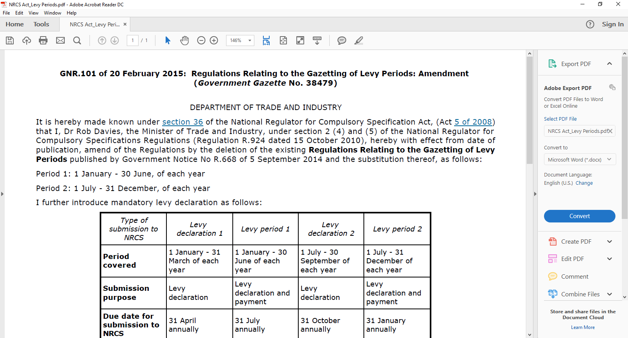
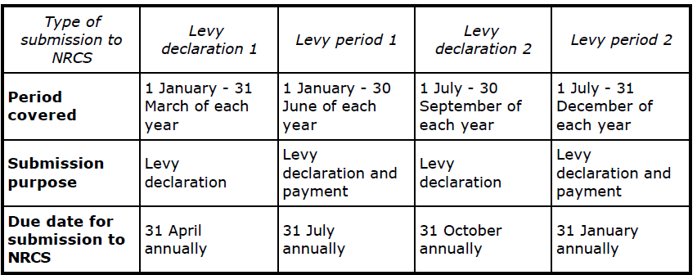
Annual Levy Declaration: Deadlines

Slide 14
Challenges
Challenges
Capacity constraints, given the resources available
The escalating cost of regulation
Generation of revenue reliant on trends and markets
Non-compliant levy payers
Internal control weaknesses – ICT system
Some clients in the industry are none compliant (levy declarations, payment)
Some clients do not declare their levy commodities in full
Some clients do not submit their quarterly declarations
In most cases, clients will make a payment without submitting a completed levy declaration
Some clients will declare Nil Returns every year even after an LOA or approval has been issued
Adverse economic conditions
Declining government funding

Slide 15
Other Matters
Successes
Strengthened Levy Audit functions
Compliance check on applications for approvals (Levy, Debtors, Fees)
Incorporate levy checks by our inspectors during their company visits
Key Strategies to address the Challenges
Automation of the NRCS levy declaration function – ERP project
Levy audit focus on non-compliance (under-declaration, incorrect declaration, non-declaration)
Ensure clients submit returns accurately and timeously as per the NRCS Regulations
Capacitating the organization through the implementation of the responsive structure which is aligned to the NRCS Mandate

Slide 16
Levy Increase Proposals for the 2023/24 Financial Year
Overall proposal
Stats SA released a report in January 2023 indicating the average annual consumer price inflation (CPI) of 6.9% in 2022. The annual CPI registered in December 2022 was 7.2%
The levy proposal increase percentage is 7.2% for the first year and subsequent increases will be based on the CPI for those years.
NRCS last increased the levy tariffs in 2019 by an average of 5%. The proposed increase for the first year is 2.2 per cent higher since the last increase.
Levy tariffs for Foods and Associated Industries
Tariffs will vary for various categories of products
The impact of the overall proposed increase will be detailed in the business unit presentation, due to a different methodology in levy determination.

Slide 17
Business Units Scope, Approaches and Rationale
Divisional Scope, Approach, Rationale and Levy Increase Proposals Schedules
BREAK AWAY SESSIONS BY REGULATED INDUSTRIES

Slide 18
Thank you
Questions
For any queries please contact Mandla Mokoena
Email: Mandla.Mokoena@nrcs.org.za
Contact Number:012 482 8754

